Slide 1
HOW I USE
MICROSOFT
TEAMS
FOR MY ONLINE CLASSES?

Slide 2
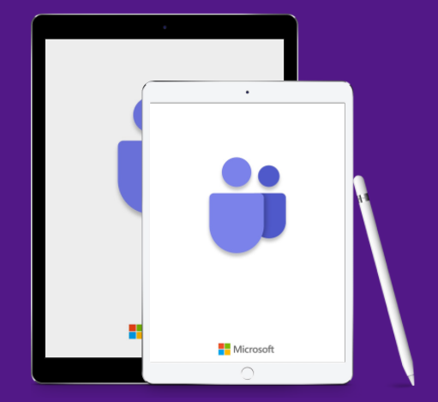
AFTER THIS PRESENTATION YOU'LL BE ABLE TO
Access MS Teams and Sign In
Learn about the Teams Interface
Learn what is a Class Team and
its different features
Learn how to access files,assignments and attend online meetings

Slide 3
HOW DO I
ACCESS MS TEAMS?

Slide 5
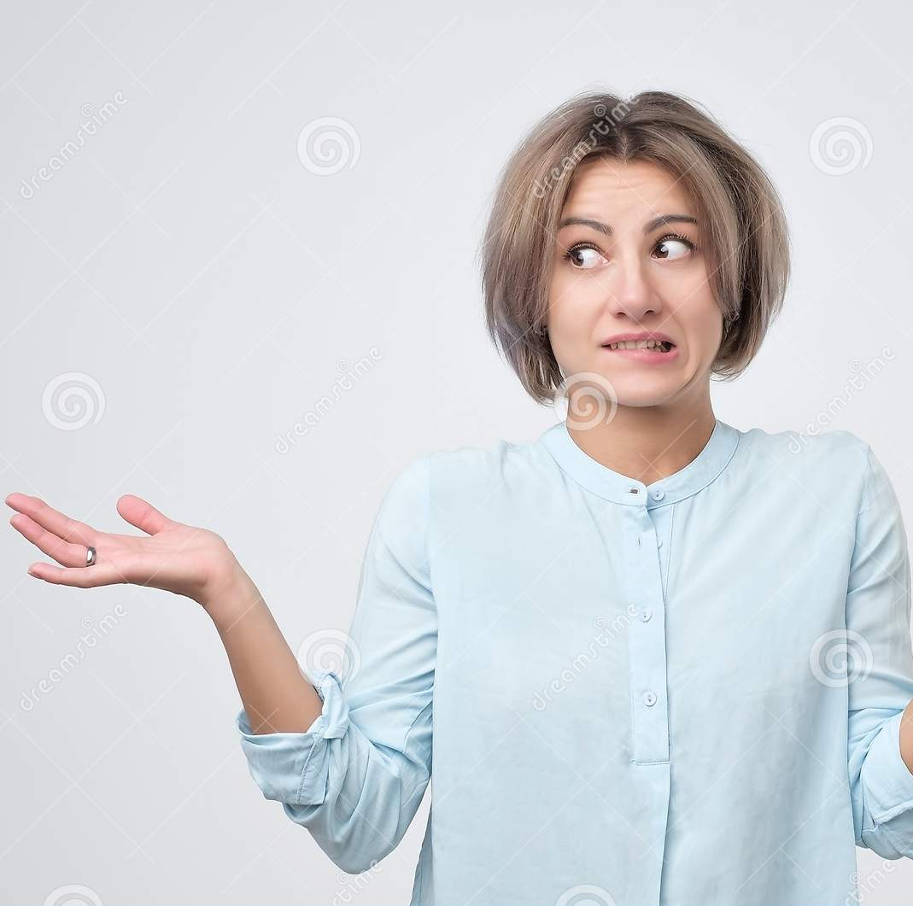
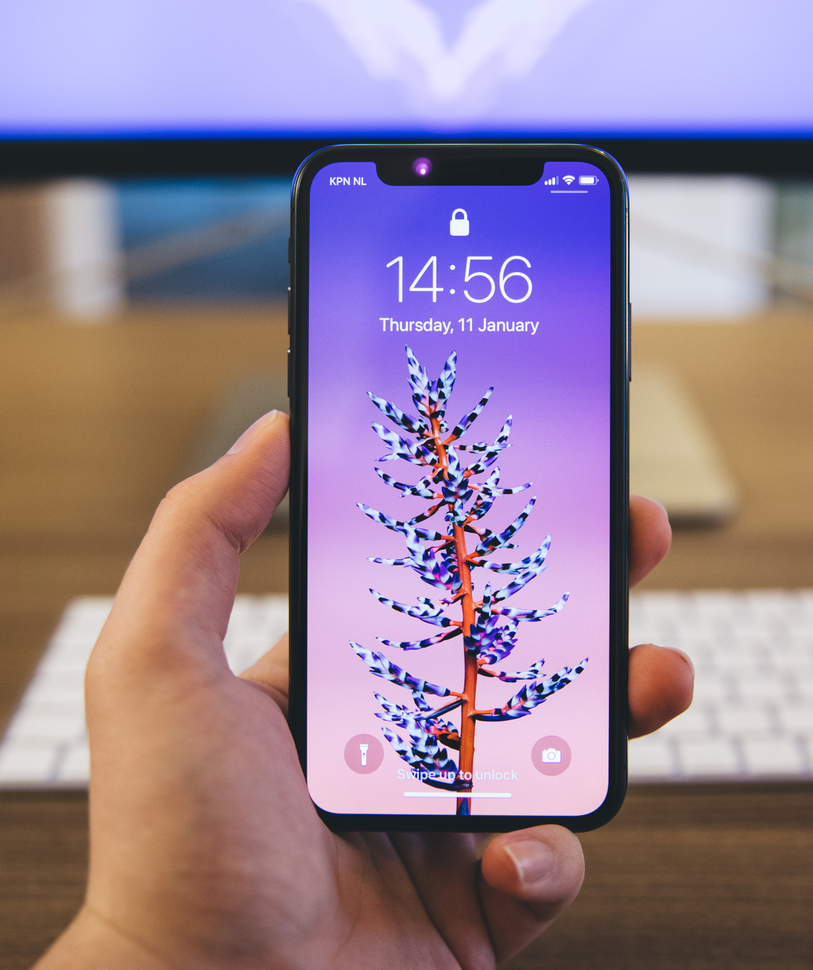
HOW DO I
MAKE A ACCOUNT ON MS TEAMS?

Slide 6
YOU ACTUALLY DON'T NEED TO! :D
The University will issue you a official Outlook Email ID and password that you will use to log in!
These account details are also availabe on your CU Online Portal.

Slide 7
HOW DO I
SIGN IN MS TEAMS?

Slide 8
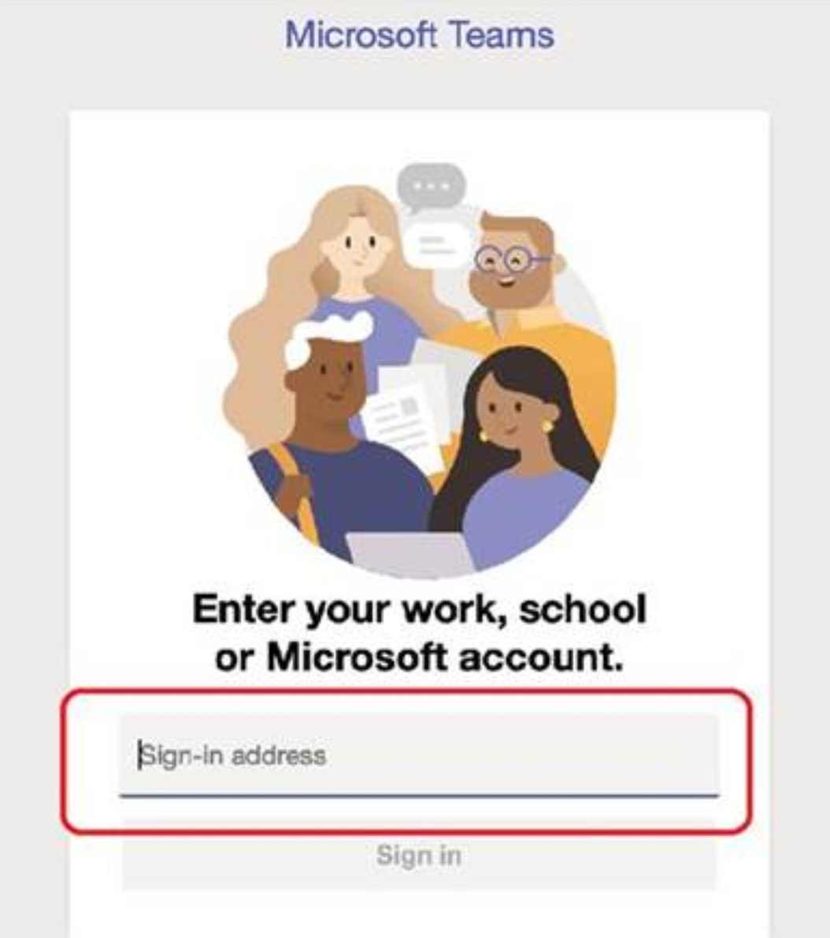
Enter the given
email & password!
FOR EXAMPLE
FA20-BPY-00@isbstudent.comsats.edu.pk
VOILAAA!

Slide 9
MS TEAMS
INTERFACE

Slide 10
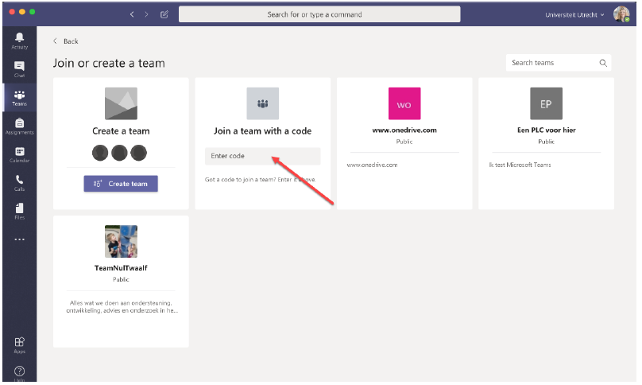
YOU CAN ENTER A TEAM CODE PROVIDED BY YOUR TEACHER HERE TO JOIN A TEAM
IF YOU ARE NOT ADDED TO ANY TEAMS

Slide 11
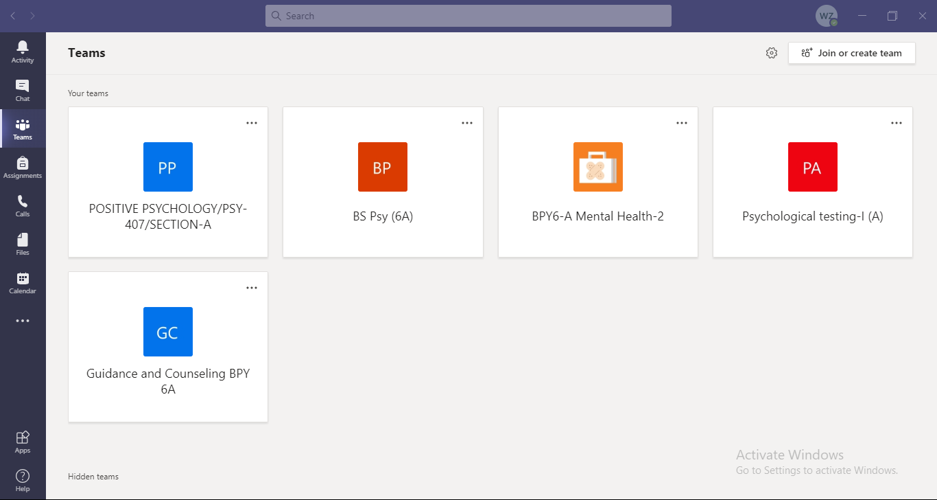
IN THIS CASE THE TEAMS TAB SHOULD LOOK LIKE THIS DISPLAYING ALL YOUR COURSES
IF YOU ARE ALREADY ADDED TO TEAMS

Slide 12
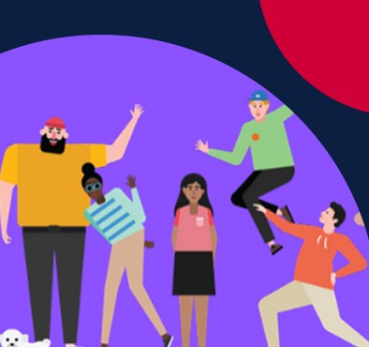
WHAT IS A TEAM?
INTERFACE & FUNCTIONS

Slide 13
WHERE TO ACCESS THE MEETING AND TEACHER POSTS?

Slide 14
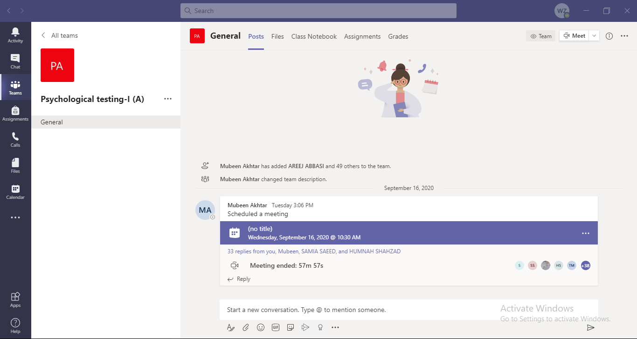
ALL THE CLASSES NOTICATION
AND POSTS BY TEACHERS OR
STUDENTS APPEAR HERE
THIS IS THE MEETING NOTIFICATION
HERE YOU CAN POST QUESTIONS OR ANYTHING ELSE

Slide 15
WHERE TO ACCESS CLASS FILES?

Slide 16
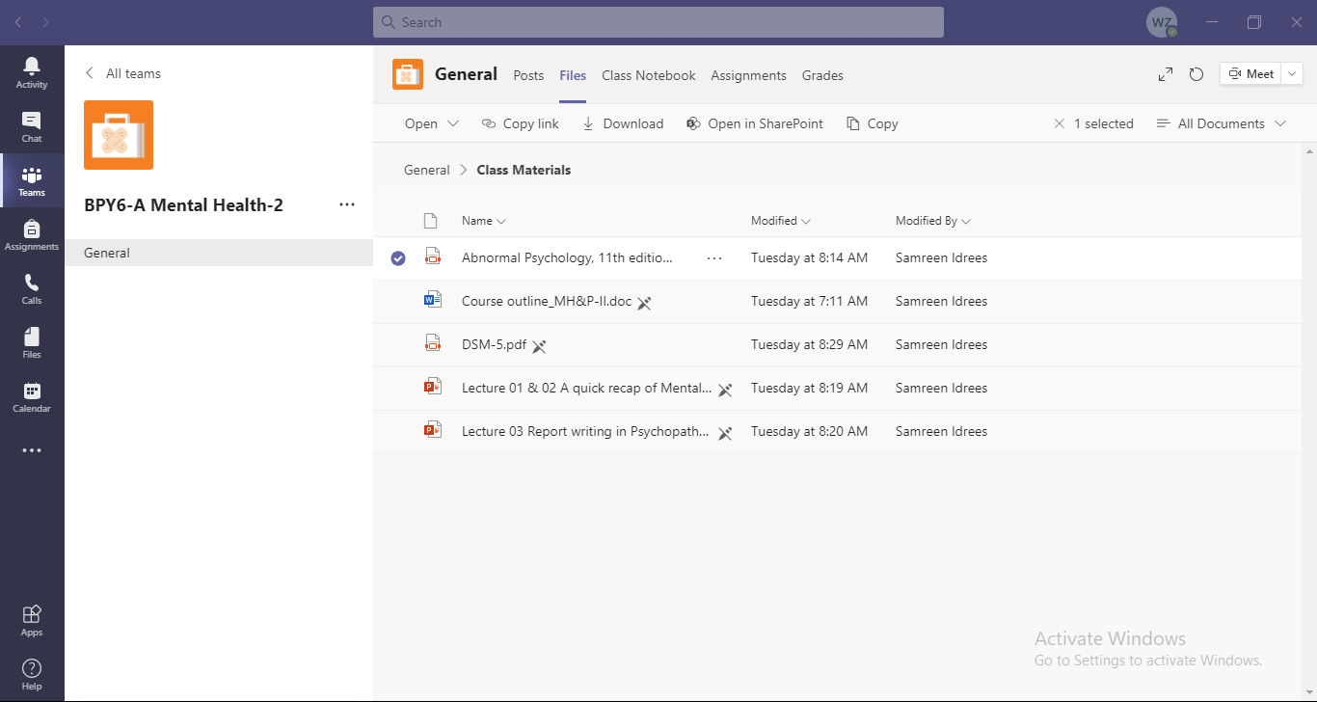
HERE YOU CAN VIEW ALL THE FILES,LECTURE SLIDES AND PRESENTATIONS ETC

Slide 17
WHERE TO ACCESS AND SUBMIT ASSIGNMENTS?

Slide 18
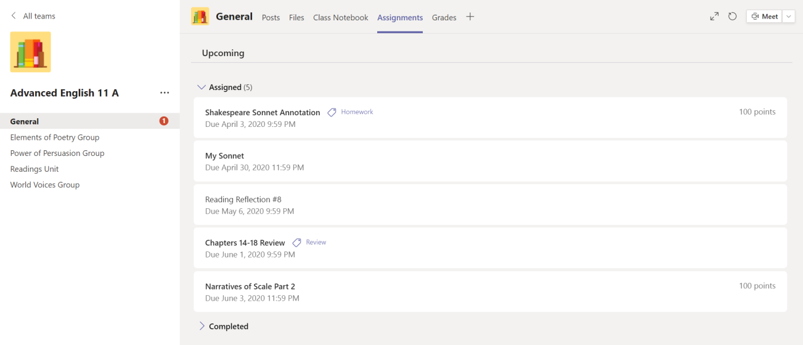
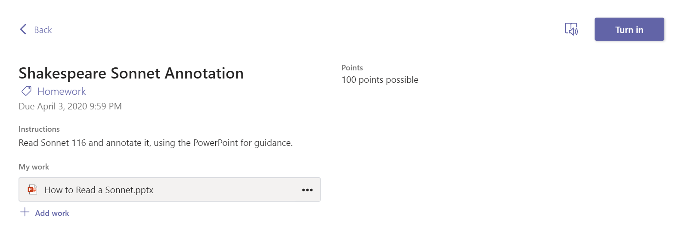
HERE YOU WILL FIND CLASS ASSIGNMNENTS IF ANY UPLOADED
( 1 )
( 3 )
( 2 )

Slide 19
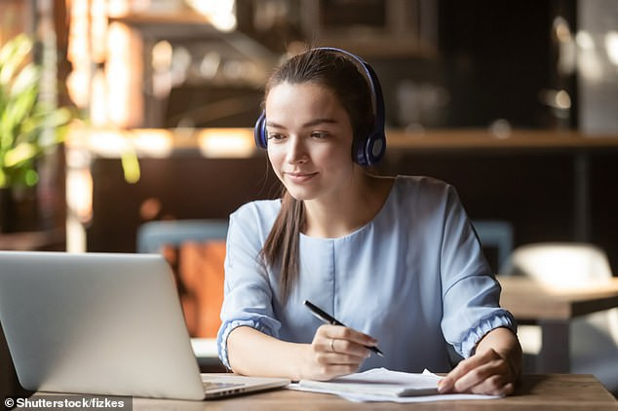
HOW TO ATTEND
AN ONLINE CLASS?

Slide 20
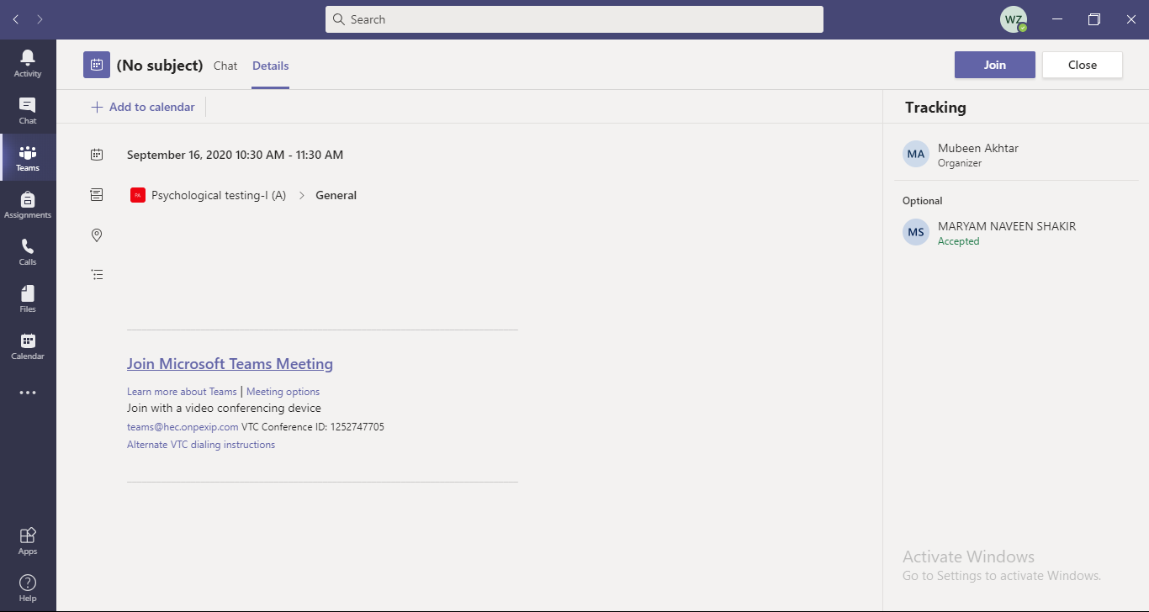
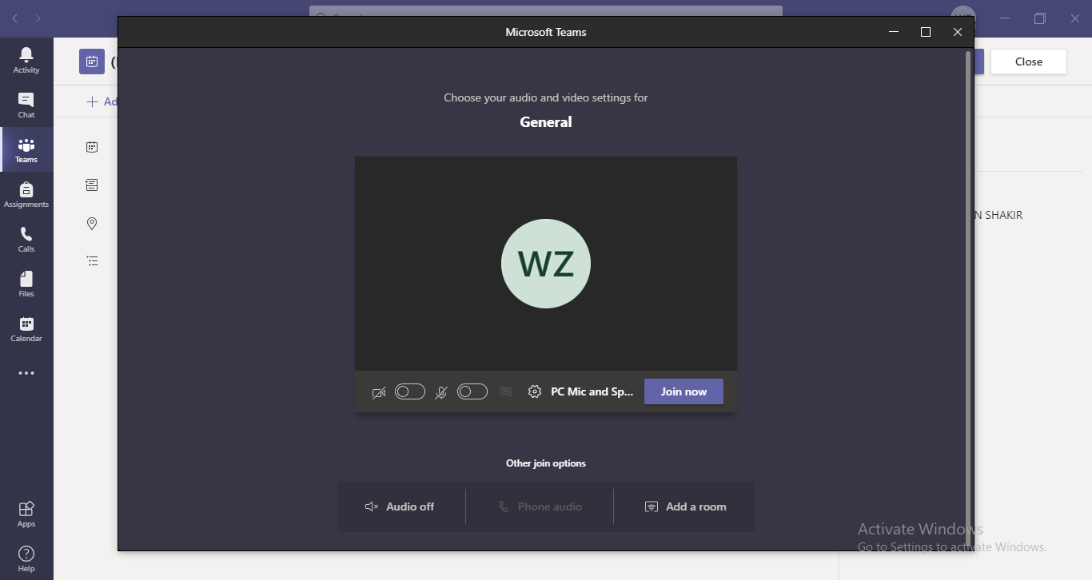
VIDEO OFF
AUDIO OFF

Slide 21
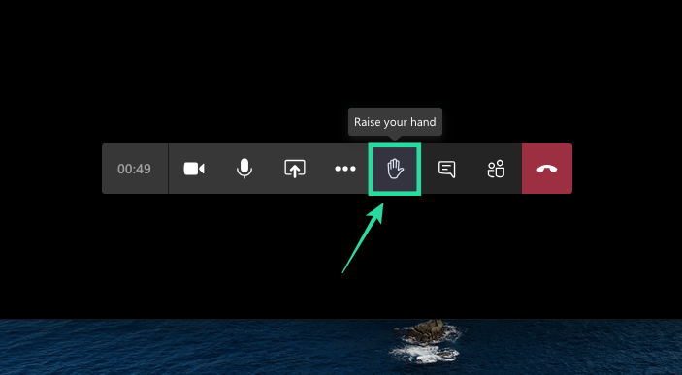
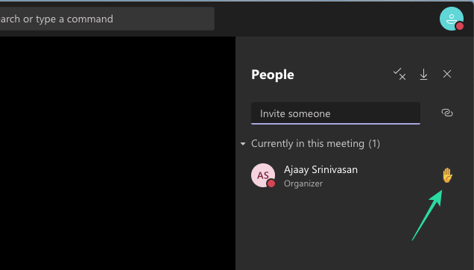
RAISE HAND FEATURE

Slide 22
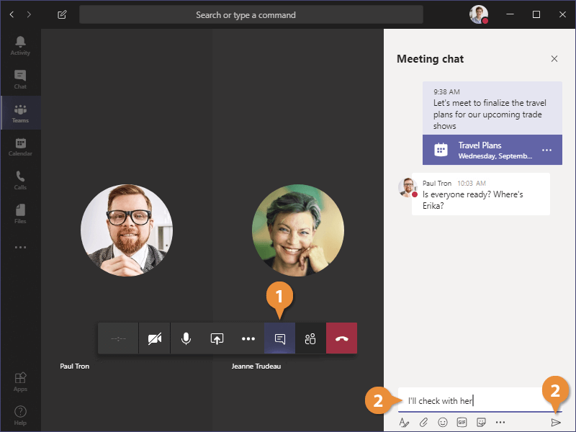
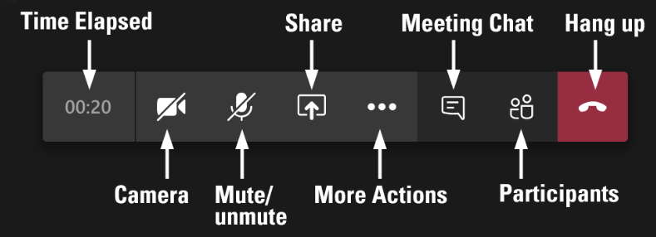
CHAT FEATURE
SUMMARY OF CONTROLS

Slide 23
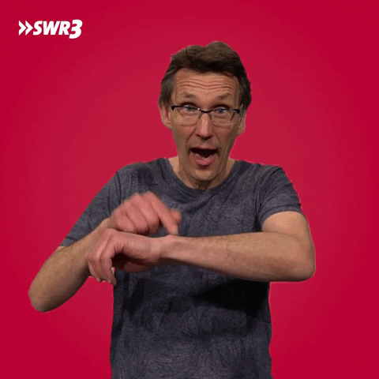
WHAT MUST YOU DO?
MEETING PROTOCOLS

Slide 24
Ensure your camera is turned off, it is not permitted for
students to have cameras on.
Ensure your microphone is muted, only unmute if asked to
do so by the teacher.
If you need to ask/respond to a question, use the “Raise Hand” function to get the teachers attention.
You can ask a question in writing using the chat function for the teacher
to respond to verbally.
Never leave the meeting unless the teacher permits you,
incase you must inform and ask persmission

Slide 25
HOW TO MAKE THE MOST OUT
OF ONLINE LEARNING?

Slide 26
Be regular and active. Missing one lectures can create more problems
for you to catch up with the lecture later on
Always do the homework on time. Study the lectures beforehand provided by teacher to make the most out of question answer session.
Keeping track is the key! Try to be punctual and stay attentive.
Ask questions to stay in interaction
Maintain discipline as you would do in a physical class. Wait for your turn and avoid unnecessary communication
Be respectful towards our teachers and class fellows. Always follow the class protocols and rules. Avoid creating distraction in class or intentional teasing

